Slide 1
Module 13 – Testing
13: Testing
Notes:
You may not have realised, but you probably have already performed testing on your code! When you run your application, most coders will check to see if key features work, and if they do, they might consider a follow-on test. That is known as exploratory testing and is a form of manual testing, usually without a plan.
As the application scales, the list of features, and expected inputs and outputs increase. And every time the code changes you will have to manually re-apply all the tests. And possibly add more. Clearly not workable.
The solution is to automate your test plan using scripts. Luckily, Python already comes with a set of tools and libraries to automate your tests for your applications. We will discover how to use the doctest module to do DocString testing, and the unittest and pytest modules to perform automated unit testing.

Slide 2

By the end of this chapter, learners will be able to:
Explain the purpose of software testing and identify key testing types.
Distinguish between manual and automated testing approaches.
Develop a simple Python calculator app and apply basic testing principles.
Write and test docstrings, including automated doctest execution.
Use assertions and structured unit tests to verify code behaviour.
Run and manage test scripts with Python test runners.
Create and execute tests using Pytest and interpret its output.

Slide 3
What is Software Testing?
Checks whether the Application meets the expected requirements
Check for Functional requirements (When I click this button, an email is sent).
Check for Non-Functional requirements (email is sent within 1 seconds and in a secure way).
Program code and logic is error free
Logical errors.
Arithmetic calculations…
Application errors
Different modules work well together.
System as a whole works.
Works on the client system.
Notes:
Software testing is the process of evaluating and verifying that a software application does what it is supposed to do and matches requirements.
It is simply to confirm that it is defect free and there is no missing functionality.

Slide 4

Why is Software Testing so Important?
Testing helps to solve problems early because:
Bugs are expensive to fix in production
Lives could be affected (Airline, transport)
Reputation could be affected
Performance and security are critical
Examples of disasters caused by not testing:
https://dzone.com/articles/the-biggest-software-failures-in-recent-years
https://www.appsierra.com/blog/software-failures-due-to-lack-of-testing?utm_source=chatgpt.com
Notes:
There are many benefits of software testing, but the prime goal is to provide the best features and experience with no bugs or side effects. This is turn builds your reputation and enhances customer satisfaction. And leads to repeat business.
It can also lead to cost savings with early defect detection, economical fixes, fewer design changes and lower maintenance costs. Comprehensive testing can also lead to better quality code with lower failure.
In this digital web enabled world, safety and security is so important. Think about buying goods online, sharing personal details, or critical infrastructure and services. Testing can improve security against hackers, malicious attacks and thefts. It can even save lives by ensuring the software in the aviation world works correctly.

Slide 5
What are the different types of test?
Tests can be categorised as these general types:
Manual or Automated
Unit Testing
Integration Testing
System Testing
Acceptance Testing
Document Testing using doctest
Test Framework using unittest
Investigate Unit testing using several Python modules:
Test Framework using pytest

Slide 6
Manual or Automated tests
Manual testing
Can NOT be designed and performed by anyone
Requires deep analysis of the requirements and specialised knowledge
Exploratory testing
Automated testing
Manually checking code may not be possible. For example, when testing:
Performance, Parallel execution
Load tests, Penetration tests…
Unit testing is often used to test code
It is the duty of the coder to write these
Notes:
You may not have realised, but you probably have already performed testing on your code! When you run your application, most coders will check to see if key features work, and if they do, they might consider a follow-on test. That is known as exploratory testing and is a form of manual testing, usually without a plan.
As the application scales, the list of features, and expected inputs and outputs increase. And every time the code changes you will have to manually re-apply all the tests. And possibly add more. Clearly not workable.
The solution is to automate your test plan using scripts. Luckily, Python already comes with a set of tools and libraries to automate your tests for your applications. We will discover how to use the doctest module to do DocString testing, and the unittest and pytest modules to perform automated unit testing.

Slide 7
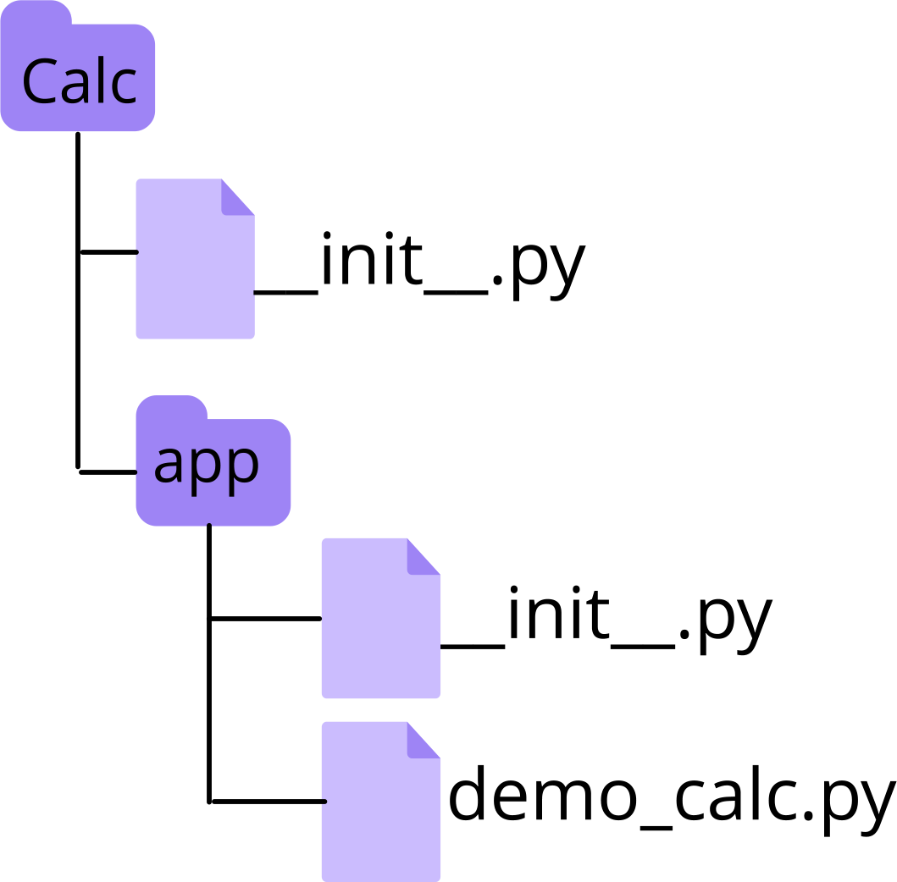
Example – a Simple Calculator App
def add(*args): total = 0 for num in args: total += num return total
def mul(*args): total = 1 for num in args: total *= num return total def div(x, z): return float(f"{x/z:.3f}")
def main(): print(f"4 + 3 = {add(4, 3)}") print(f"4 * 3 = {mul(4, 3)}") print(f"4 / 3 = {div(4, 3)}") return None if __name__ == "__main__": main()
Demonstration
Create a new Package called Calc
Notice the __init__.py file
Create a sub package called app
Create a new script in the app folder called demo_calc.py
Define add, multiply and divide functions
Add and multiply functions should allow multiple parameters
Define main() function to call functions
Notes:
To practice our testing capabilities, we will create a simple calculator application demo_calc.py with add, multiply, and divide operations.
Test the program by creating a main() function that calls all the functions with two simple parameters 4 and 3. Execute the program and confirm that all is well.
You may have done some of these steps in an earlier chapter.

Slide 8
Example – a Simple Calculator App
Manual testing on the REPL or command prompt.
>>> import sys
>>> sys.path.append(r"c:\labs\Calculator")
>>> import demo_calc
>>> demo_calc.add(4, 3)
7
>>> demo_calc.mul(4, 3)
12
>>> demo_calc.div(4, 3)
1.333
C:\labs\Calculator> python demo_calc.py
4 + 3 = 7
4 * 3 = 12
4/3 = 1.333
C:\labs\Calculator>
Notes:
Test the app manually by executing the script in your command prompt or importing the script at the REPL prompt and calling the functions manually. You may have to import the sys module and append the location of the script to the sys.path list.
You might want to manually test the add and multiply functions with multiple numeric parameters.
You did remember to put comments in your script or is there a better way to document your script?

Slide 9
Document Strings and Testing
Document and test your code – Docstrings:
Documents the script
Documents the functions
PEP 008 compliance
Provides help()
It can be tested!
Notes:
If you are interested in writing your documentation at the same time as the code and want to incorporate test cases at the same time, then Python’s doctest module should be considered.
It provides a simple testing framework that allows you to document your script with test examples and automate the testing of these examples – and helps keeps your code and documentation synchronised.
Some coders would say that documentation is just as important as code, and some may even argue it is more important. But all would agree that anything that helps testing is a good thing!

Slide 10
Docstrings – Format and Location
Docstrings are triple quoted strings that document your code, as you code:
Module docstrings placed before any code
Function/class docstrings at start of block before any code
Can be simple single line or multi-line
demo_calc2.py
“””
Calculator program with add, multiply, and
divide functions.
“””
def add(*args): """ Returns the sum of all parameters """ total = 0 for num in args: total += num return total
def mul(*args): """ Returns the product of all parameters. """ total = 1 for num in args: total *= num return total
def div(x, z): """ Returns x divided by z, as a float to
3 decimal places.
""" return float(f"{x/z:.3f}")
Notes:
Comments are useful for describing code and in Python we use a # symbol for single line comments. Unfortunately, these comments are ignored by the interpreter, unavailable at runtime and can often become out of date!
Step forward, docstrings – these triple quoted (single or double) strings allow multi-line comments that remain within your code at runtime. They are displayed with the built-in help() function and modules such as MkDocs and Sphinx can be used to generate project documentation.
The special attribute __doc__ for packages, modules, classes and functions.
Docstrings can be added to packages, modules, classes, methods and functions and are described in the PEP 257 document.

Slide 11
Docstrings – for User Documentation
Use help() to see the docstrings:
Or the special attribute __doc__:
Use pydoc module to display in text or HTML:
>>> help(demo_calc2)
>>> help(demo_calc2.add)
>>> print(demo_calc2.__doc__)
>>> print(demo_calc2.add.__doc__)
c:> %PYTHONPATH%\pydoc demo_calc2.py
c:> %PYTHONPATH%\pydoc -w demo_calc2.py
Notes:
Use the built-in help() function to display the embedded docstrings. You can also display the docstring for a specific function/method by using the dot notation – help(demo_calc.add).
Alternatively, within a script, you can print out docstrings using the special __dot__ special attribute which can be combined with package, module, class, function or method names.
The pydoc module, from the Python standard library, can also be used on the command line to print out the docstrings in text or html using the –w option.

Slide 12
Docstrings – for Usage Examples
Docstrings can also have embedded USAGE examples:
Same format as testing at REPL prompt
Can have multiple examples in each docstring
def mul(*args): """ Returns the product of all parameters.
>>> mul(4, 3)
12
""" total = 1 for num in args: total *= num return total
def div(x, z): """ Returns the result of x divided by z,
as a float to 3 decimal places.
>>> div(4, 3)
1.333
""" return float(f"{x/z:.3f}")
def add(*args): """ Returns the sum of all arguments
>>> add(4, 3)
7
>>> add(10, 20, 30)
60
""" total = 0 for num in args: total += num return total
Notes:
You can also embed USAGE examples of each function in the docstrings. These examples are in the same format as the calls you would make at the REPL (>>>) prompt and include input parameters and expected output. The function must be deterministic which means it should always return the same output for the same inputs.
This helps the user understand how to call the function and what is expected out for given parameters, and how to manually test the function is working and matches the documentation.
But there is another benefit of USAGE examples in docstrings..

Slide 13
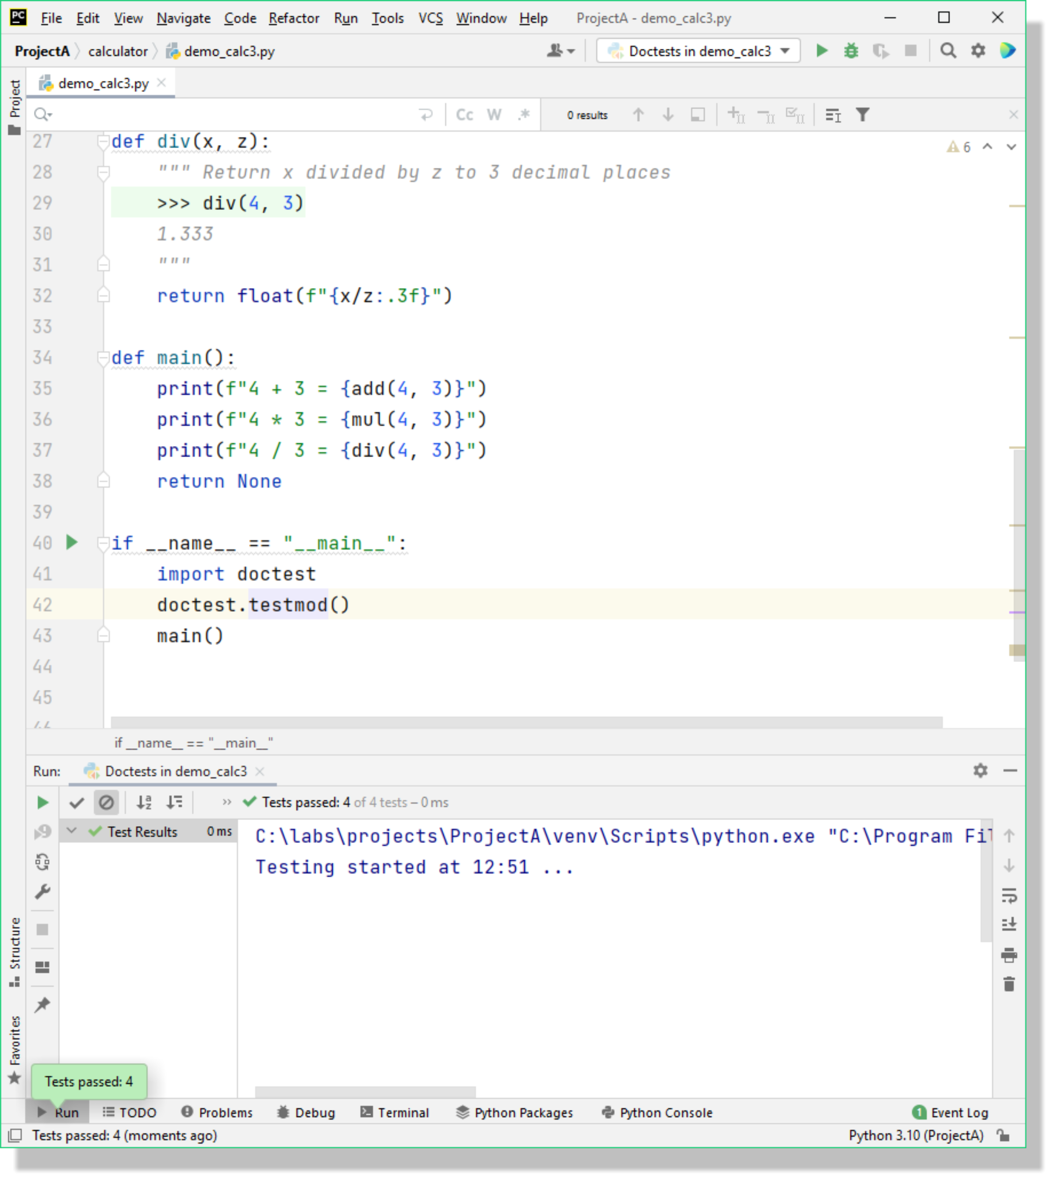
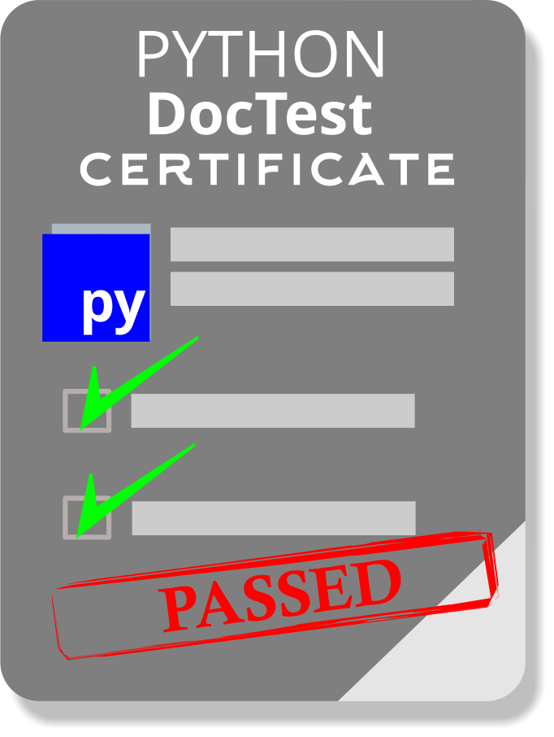
Docstrings – for Automated Testing
Docstring USAGE examples testing can be automated:
Import the doctest standard library module.
Execute testmod() function
def main(): print(f"4 + 3 = {add(4, 3)}") print(f"4 * 3 = {mul(4, 3)}") print(f"4 / 3 = {div(4, 3)}") return None if __name__ == "__main__": import doctest doctest.testmod() main()
Notes:
The doctest module provides a framework for simple and quick automation of acceptance tests for integration and system testing. These are important as integration testing are used to confirm that the different components of your application all work together. And system testing is used to confirm that you have ticked off the specifications for your project.
Docstrings and doctests can be embedded at the package level down to the class, function and method level. At the higher package level, they can be used for integration testing and at the lower function level they are suitable for unit testing – check the code and documentation as you code!
And the document tests can even be written before the code! How about that for a good idea!

Slide 14
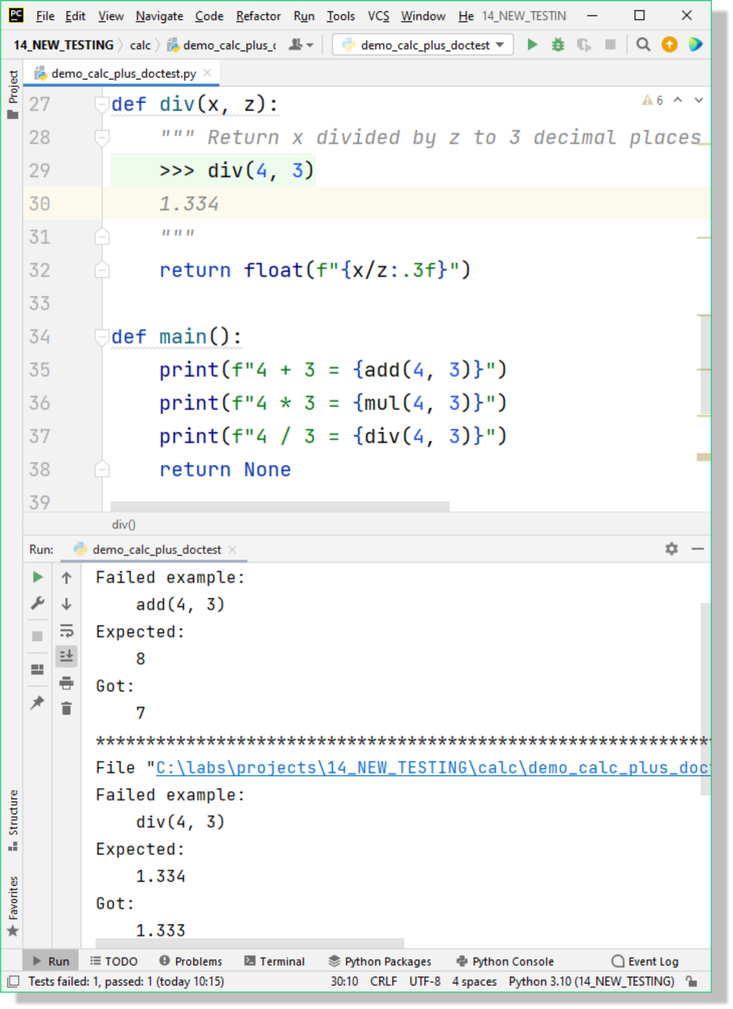
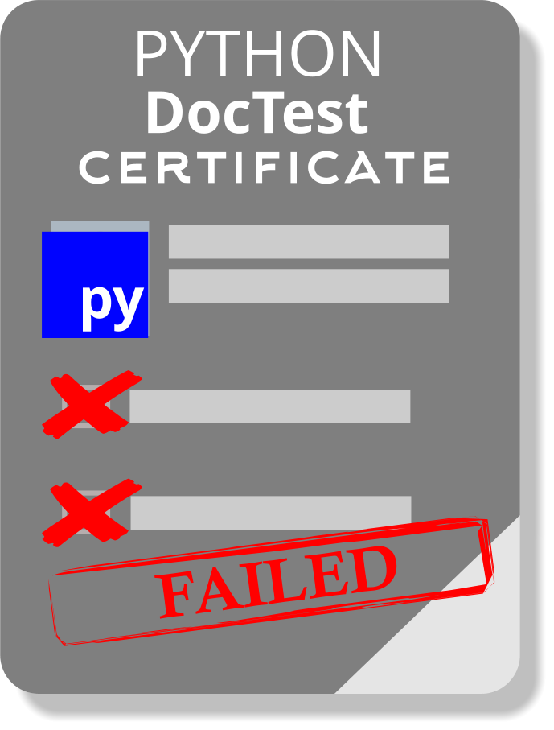
Docstrings – for Automated Testing
Docstring USAGE examples testing can be automated:
Apply an error in your docstring and test again.
def add(*args): """
>>> add(4, 3)
8
"""
def div(x, z): """
>>> div(4, 3)
1.334
"""
if __name__ == "__main__": import doctest doctest.testmod() main()
Failed add test
Failed div test
Notes:
In this example, we apply two errors to the DocStrings and re-run the automated testing.
You will notice in the output that Expected and Actual values are highlighted and a summary of how many failures occurred. This can happen when code is changed and the DocStrings are not updated accordingly.

Slide 15

Testing Using Unittest
Unit testing:
Unit vs integration testing
Assertions
Using the unittest module
Notes:
Testing your documentation versus the code is one form of testing. But how do test that our application is working completely and do the individual features all work correctly. In this part, we will examine integration testing versus unit testing, and will discover how simple it is to perform unit testing using the Python library module unittest.

Slide 16
Unit Testing Vs Integration Testing
How to diagnose a complex application or project?
Unit testing
First level of testing
Tests individual units of code — functions, classes, and methods
Often white box testing, performed by the developer
Integration testing
Second level of testing
Verifies that multiple components work together as a complete system
Often black box testing, typically performed by a dedicated test team
Test step: call a function with parameters
Test Assertion: Verify that the output or behaviour is correct
Notes:
When we buy a new car, we trust that the manufacturer has thoroughly tested it before it leaves the showroom. Each part, such as the engine, battery, or fuel gauge, is tested individually to ensure it works correctly. This process is known as unit testing.
Once all the components are assembled, the manufacturer performs further tests to verify that they function properly together - this is integration testing,
and can be more challenging. For example, if the car doesn’t start, there could be many causes: a flat battery, a faulty starter motor, or a wiring issue. Each component may work on its own, but something in the combination has failed.
In software development, the developer typically performs unit tests on their code - testing individual classes, functions, and methods during the coding phase. Integration testing is often handled by a separate test team, using predefined test scripts and tools. In testing terms:
Test Step: turning the key or pressing the start button.
Test Assertion: observing that the engine turns over and dashboard lights come on - confirming it behaves as expected.
Modern cars often include built-in unit tests in their software, alerting the driver when something isn’t working correctly - for instance, low fuel, low battery, or a system fault indicator.

Slide 17
Unit Testing – using assert
Python has a built-in function called assert() for performing unit testing.
The assert statement:
Convenient method of inserting debugging assertions.
Raises an exception based on a Boolean expression.
An AssertionError is raised if boolean is False.
Can have an optional expression.
Can be ignored when optimisation is requested at runtime by:
PYTHONOPTIMIZE = 0
Command line option, python -O
Notes:
Python supports tools and modules for performing Integration and Unit testing, but in this session we will be focusing on performing unit testing.
The Python built-in assert() function has been inspired by the equivalent function in C/C++ although it has a different behaviour. It is designed to provide sanity testing within code rather than a full-blown test function. It is designed to be used during development so that the program would fail and generate an AssertionError if an expression fails. Probably not what the end-user would like to see in production code. So either, remove from production code or test the __debug__ special attribute before using the assert statement.
The __debug__ attribute can be altered by enabling the compiler for optimization by setting the PYTHONOPTIMIZE=0 environment variable or with a command line switch (-O).

Slide 18
Unit Testing – Test Cases
""" Test Cases for Calculator app.: """ from calculator import demo_calc def test_add(): assert demo_calc.add(4, 3) == 7, "Error should return 7" assert demo_calc.add(10, 20, 30) == 60, "Error should return 60" return None def test_mul(): assert demo_calc.mul(4, 3) == 12, "Error should return 12" return None def test_div(): assert demo_calc.div(4, 3), "Error should return '1.333'" return None def main(): """ Execute Test functions """ test_add() test_mul() test_div() print("Everything passed") return None if __name__ == "__main__":
main()
Test Cases:
Write your test cases in a separate file
Keeps code and testing separate
Could write tests before the code
Downside is only the first failure is displayed
Test Runners:
Specialised tools for running tests
Checking output
Debugging and diagnostic tools
unittest and pytest are popular
Notes:
Rather than keeping your assert statements in your production code, it may be wiser to have them in a separate Python file. These are called a test case, and you could put all the test cases for your program in this file. This method of structuring your tests is great for simple checks, but what if multiple tests fail – only the first one would be displayed.
The solution is to use a test runner, this is a special application for running tests, checking their output and provides additional debugging and analysis tools.
There are several test runner modules to choose from including unittest, pytest and nose2. In this session we will investigate using unittest and pytest.

Slide 19
Unit Testing – Test Runners
tests\test_demo_calc.py
import unittest from calculator import demo_calc class TestCalc(unittest.TestCase): def test_add(self): self.assertEqual(demo_calc.add(4, 3), 7, "Should be 7") self.assertEqual(demo_calc.add(4.2, 3.5), 7.7,
"Should be 8.7") return None def test_mul(self): self.assertEqual(demo_calc.mul(4, 3), 12, "Should be 12") self.assertEqual(demo_calc.mul(102, 3, -2), -612,
"Should be -612") return None def test_div(self): self.assertEqual(demo_calc.div(4, 3), 1.333,
"Should be 1.333") return None
if __name__ == "__main__": unittest.main()
The unittest module:
Part of Python standard library
Provides a testing framework and test runner
Popular in commercial and open-source projects
unittest
Create TestCalc class
Inherit from unittest.TestCase
Tests to be defined as methods in a class
Requires some knowledge of OOP
Uses special assertion methods
Notes:
The unittest module has been part of the Python Standard Library since version 2.7. It provides a structured testing framework and test runner, widely used across both commercial and open-source projects.
Because tests are defined as methods within a class, a little knowledge of object-oriented programming (OOP) is helpful. Each test class must inherit from unittest.TestCase, which provides a rich set of assertion methods for writing and validating test cases.
Converting Existing Test Cases
To convert simple tests into unittest style:
Import the unittest module
Create a new class, e.g. TestCalc, that inherits from unittest.TestCase
Replace built-in assert statements with unittest assertions
Prefix each assertion with self (since they’re class methods)
Run the test suite using unittest.main() instead of a manual main() call

Slide 20
Unit Testing – Test Runners and Assertions
Method | Equivalent
assertEqual(a, b) | a == b
assertTrue(x) | bool(x) is True
assertFalse(x) | bool(x) is False
assertIs(a, b) | a is b
assertIsNone(x) | x is None
assertIn(a, b) | a in b
assertIsInstance(a, b)
assertRaises(a, *args) | a == Exception
unittest Assertions:
Numerous methods to assert test on..
values
types
existence of variables
Name file starting with ‘test’
Writing assertions:
Tests should be repeatable.
Deterministic/predictable.
Relate to your input data.
In this example, we are testing for the function raising an exception.
def div(x, z): """ Returns x divided by z, as a float. """ if z == 0: raise ZeroDivisionError("Divisor must be zero") return float(f"{x/z:.3f}")
def test_div(self):
self.assertRaises(ZeroDivisionError, demo_calc.div,
4, 0) return None
Notes:
The unittest module provides a wide range of assertions and capabilities beyond the built-in assert() statement. These include checks for whether values are equal or not equal, whether variables exist or match a specific type, whether expressions are True or False, and whether exceptions are raised as expected.
At the REPL prompt, you can explore all available assertions by importing the module and using:
import unittest
help(unittest)
This will display the full list of assertion methods and their usage.
The example on this slide demonstrates how to test whether a ZeroDivisionError is raised in your code.
When writing assertions, aim for tests that are:
Repeatable – consistent every time they’re run
Deterministic – same input always produces the same result
Data-driven – closely related to the input values being tested

Slide 21
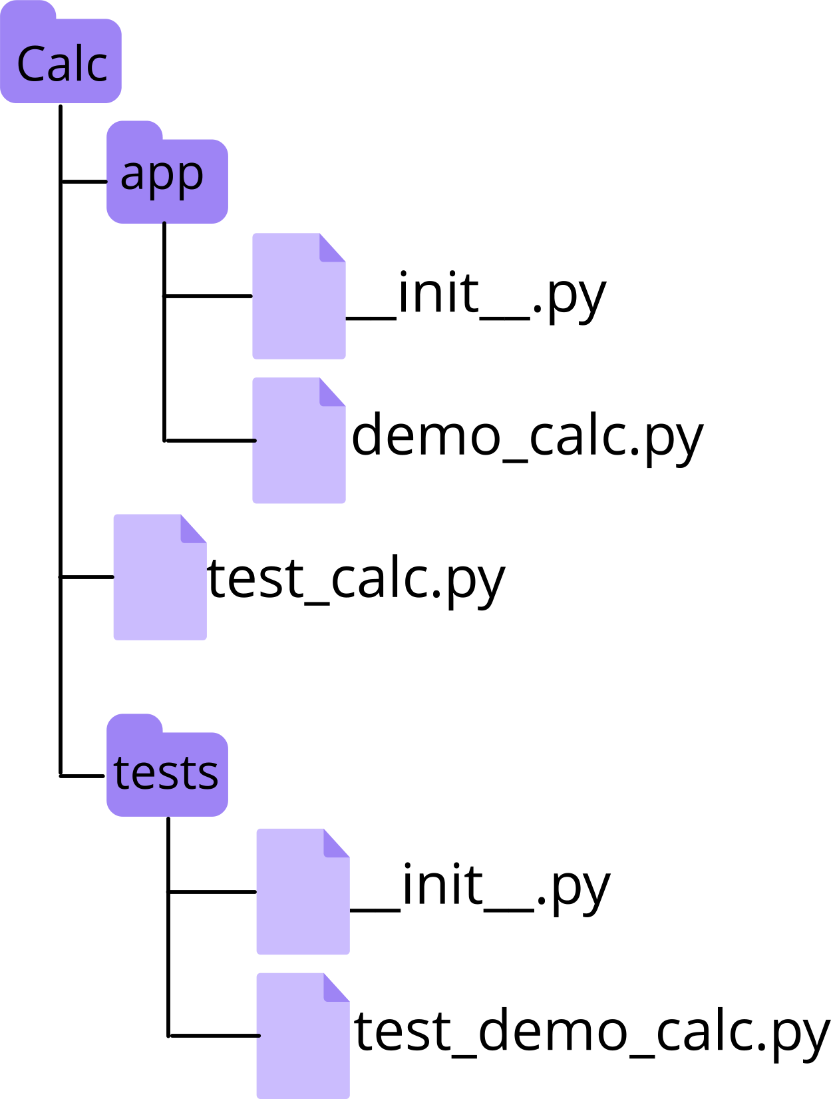
Test Scripts – Location and Executing from Command Line
Standard test cases:
Located in folder above application folder.
Needs to be able to import application.
Name file starting with ‘test’.
Complex test cases:
Create a sub package called tests.
Split tests into files starting with ‘test*.py’.
Running a single test module:
Running a single test case:
Running all tests:
C:\Calc\> python –m unittest tests.test_demo_calc
C:\Calc\> python –m unittest tests.test_demo_calc.test_add
C:\Calc\> python –m unittest discover
Notes:
When writing simple test scripts, locate them in the folder above the application folder as they will need to import the application. Give the script a name starting with ‘test’.
Once the script becomes too large than it is advisable to create a sub package called tests and split the test script into separate files; the convention is to give the file names starting with ‘test_’. The tests package folder should be in your main project folder.
Remember the __init__.py file indicates that the calculator and tests folders can be imported as a module from the parent directory.
The test scripts can be executed from the command line in several ways by importing the unittest module and then the test module or test function as an argument. Alternatively, if you have named your folder and scripts with the prefix ‘test’, then you can tell the unittest module to ‘discover’ and execute all test folders and scripts.

Slide 22
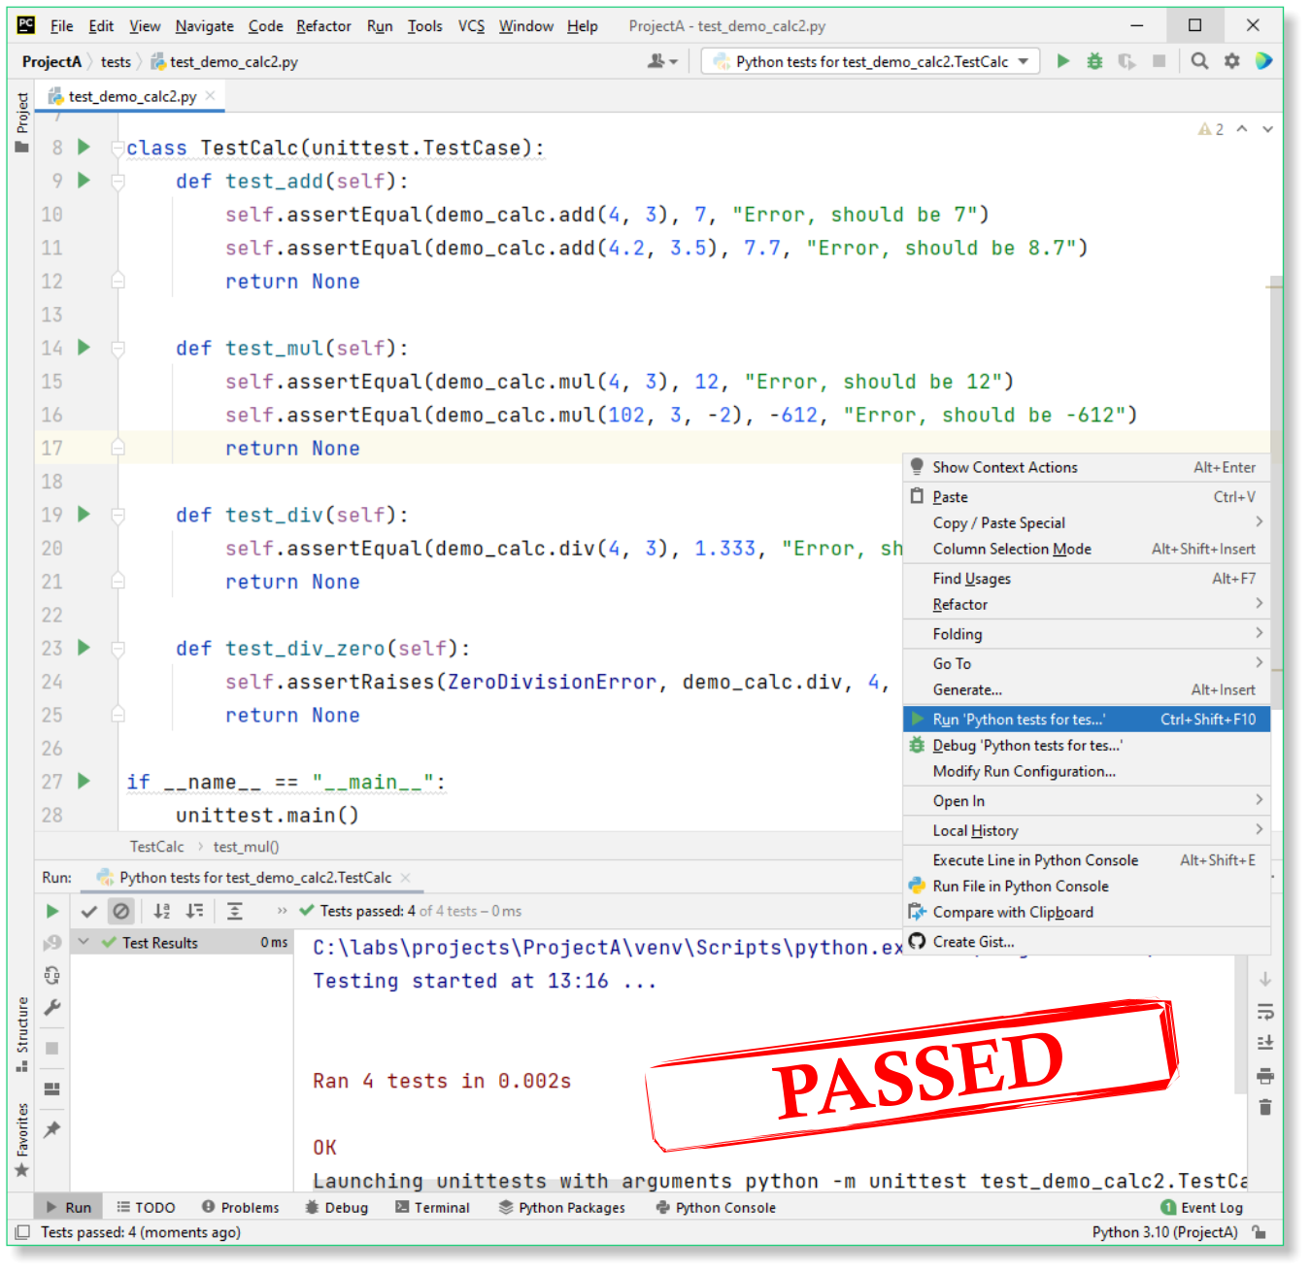
Test Scripts –Executing from Pycharm
Executing your test script in Pycharm:
Right-click > Run Python Tests > script.
Or Click Run Button next to Namespace trick
Or Menu > Run > Run Python Tests > script
Test runner executes your test code.
Test result in console.
Run Python Tests
Click Run button
Test Results
Notes:
To execute your test script, you can either right-click the file and choose “Run Python Tests”, or use the Run → Run Python Tests menu option in your IDE.
This triggers unittest.main(), the built-in Test Runner application, which discovers and runs all test cases within your script.
It interprets your test methods, executes them in sequence, and reports the results in the console, typically showing which tests passed, failed, or were skipped, along with summary statistics.
Each test method defined within a unittest.TestCase class is created and executed as a separate test object.
This means that before each test runs, the framework constructs a new instance of the test class, ensuring that tests are independent of one another.
Any variables, states, or resources set up during one test are not shared with others, making each test self-contained and isolated - a key principle of reliable automated testing.

Slide 23
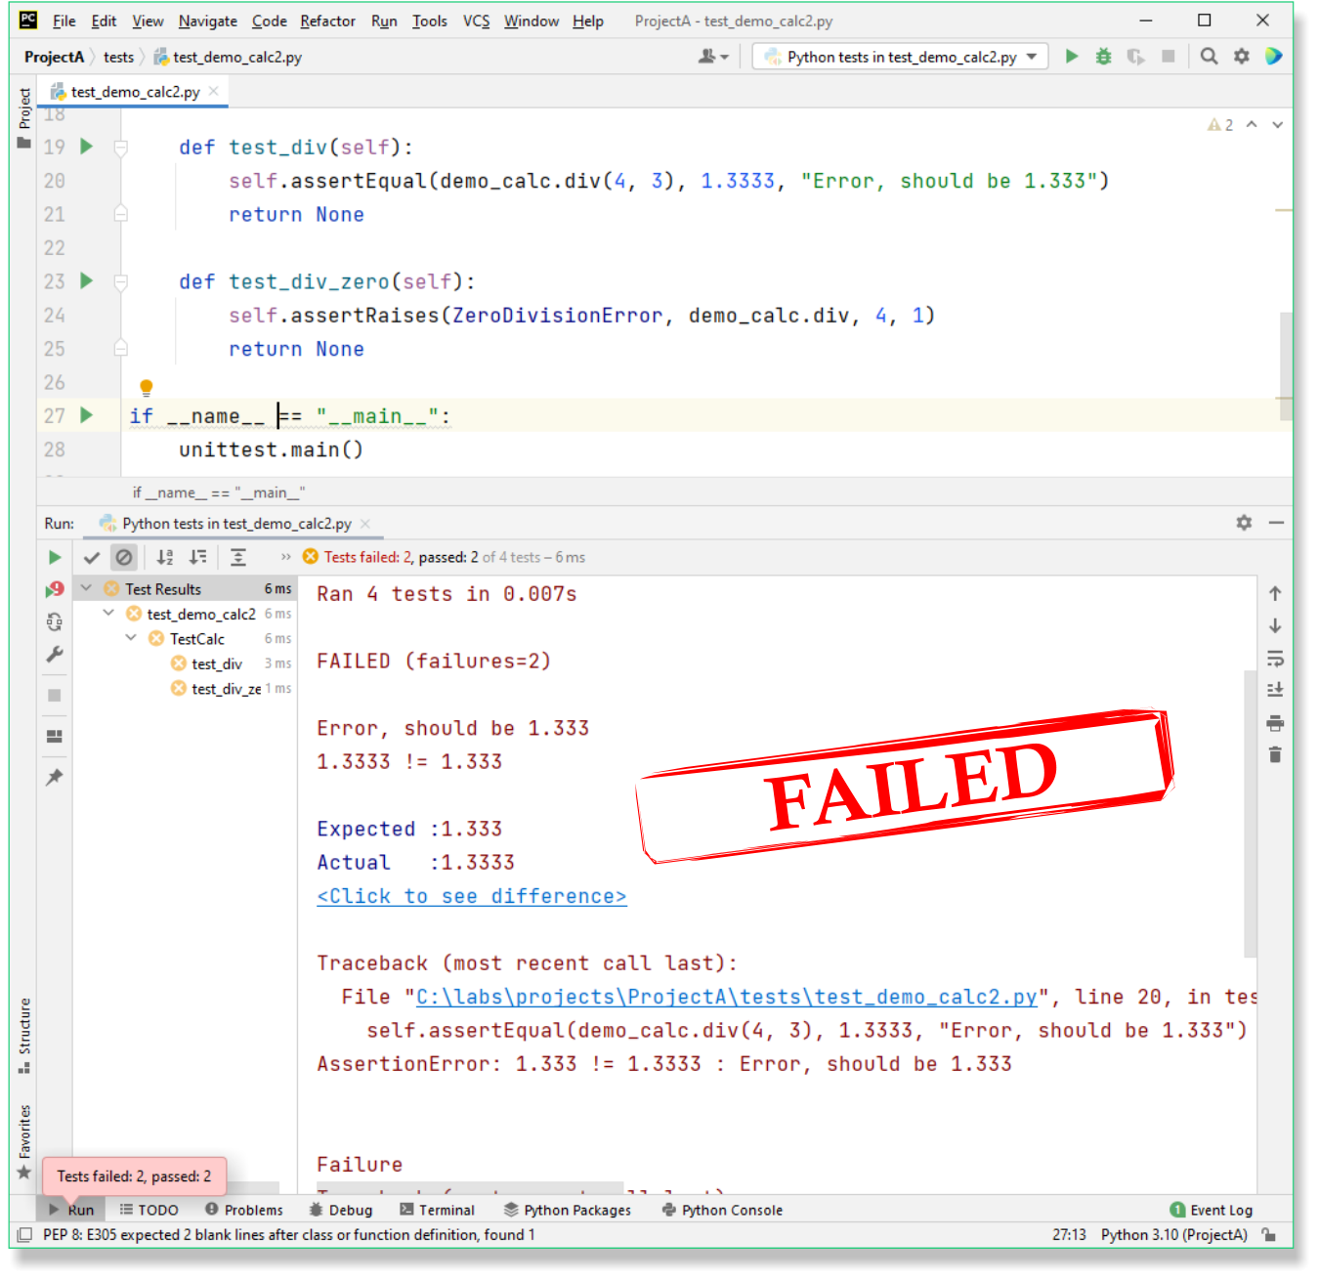
Test Scripts –Executing from Pycharm
Edit your Test script to report failures:
Execute the Test script again
In the output:
Execution results
Number of failures
Detailed about each failed entry
Traceback to failed line of code
The assertion and expected and actual result
Edit Test to Fail
Click Run button
Test Results
Notes:
Edit your test script intentionally to make it fail.
In the example on the slide, the expected result of the division has been changed to use four decimal places instead of three, and the parameters have been modified so that a ZeroDivisionError is not raised.
Run the test runner again and observe the console output.
You’ll see the total number of failed tests, along with detailed feedback for each one, including a traceback to the exact line that failed, and a comparison between the expected and actual results.
In the test navigation window, you can switch between viewing all test results or inspecting individual test cases, making it easy to locate and analyse specific failures.

Slide 24
Testing Using pytest
Unit Testing:
Boilerplate code
Using the pytest module
Common data for testing using fixtures
Varying data for testing using parametrization
Notes:
As good as the unittest module is, it still has some shortcomings including its interface. There are several alternative testing frameworks and pytest is one the most popular. It is feature rich, has additional plug-ins and is more pleasing to use. It can even run your existing tests out of the box including those written using unittest.
In this session, we will examine, how to create a test runner using Pytest.

Slide 25
Boilerplate Vs Elegance
Tests should be readable and consist of minimal information to understand the test case.
Unittest module:
Part of the Python standard library
Boilerplate code
Repeated verbose code
Import module, create class, inherit from TestCase
Write special methods for each test case
Use one of the many self.assert* methods
Pytest module:
Must be installed first
Simple test functions (no classes or methods required)
Uses built-in assert() function or any expression that evaluates to True
Elegant and simple, and nicer output
Notes:
In programming, boilerplate code refers to sections of code that are verbose, repetitive, and often reused with minimal variation.
You may have noticed this while using the unittest framework.
Before writing any actual assertions, you first need to import unittest, create a new class, inherit from TestCase, and then define individual methods for each test case using one of the many self.assert*() methods. And this process must be repeated for every test script! Some developers find this structure wordy, less readable, and even a bit boilerplate-heavy.
An alternative is to use the pytest module, which removes much of this overhead. With pytest, you can simply write plain test functions using the familiar built-in assert() statement or Boolean expressions.
If you already understand assert(), the learning curve is very gentle compared to mastering unittest. The only convention you need to follow is to prefix your test files and functions with the word test, for example, test_demo_calc.py.
And as a bonus, pytest provides cleaner, more readable output when you run your tests.

Slide 26
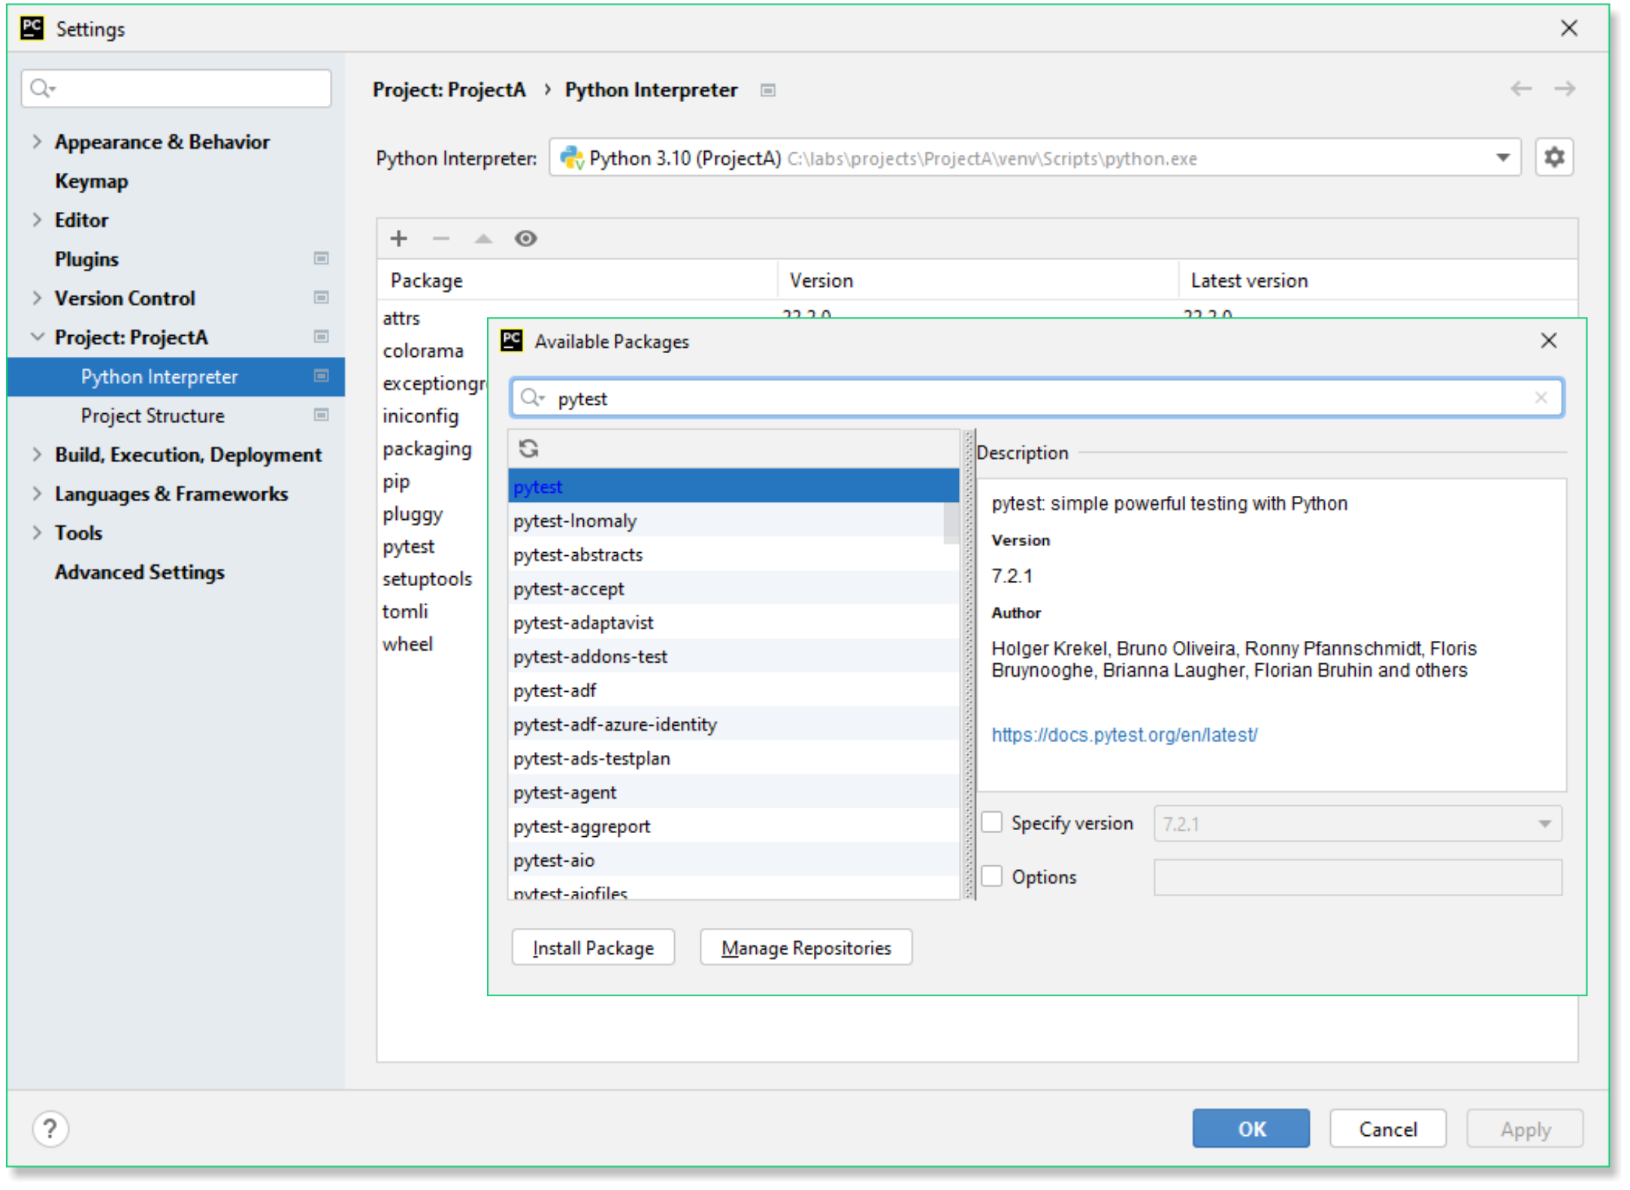
Installing pytest
Pytest is not part of the Python standard library – it can be installed from the:
Command line:
Can be installed in a virtual environment (venv) using pip
Change into your project folder
Pycharm:
File > Settings > Project > Project Interpreter
Select +
Search pytest
Select Install pytest
c:\ProjectA> python –m venv venv
c:\ProjectA> .\venv\Scripts\activate
(venv) c:\...\ProjectA> python –m pip install pytest
Notes:
Pytest needs to be installed first as it is not in the Python standard library. It can be installed from the command lines using pip or from within up your IDE – for example, Pycharm. It can also be installed in a virtual environment.
Pytest: https://docs.pytest.org/en/7.2.x/
As an aside, if you are not familiar with Virtual Environments then ask your instructor or use the links below. A virtual environment is a way to isolate a Python interpreter with its own independent set of library modules and versions; so that different projects can manage their own dependencies.
Several Virtual environments are available including venv (python only), conda (python and other languages) and anaconda (commercial environment and package manager) to choose from.
Venv: https://docs.python.org/3/library/venv.html
Conda: https://docs.conda.io/projects/conda/en/stable/
Anaconda: https://www.anaconda.com/products/distribution

Slide 27
Pytest Output
Command line – reporting success
Execute pytest in your project folder
Discover test scripts
Nicer output – dot (test passed), F (Failed), E (Exception)
(venv) C:\project\Calc> pytest
Notes:
Execute pytest at the command line inside your project folder and it will discover all the existing test scripts (with a ‘test’ prefix).
The report displays the system state, version of Python and pytest and optional plugins. The folder to search for tests and the number of tests discovered.
The output indicates a dot (test passed), an F (test failed) or an E (Exception raised). The overall progress of the test cases are displayed as a percentage.

Slide 28
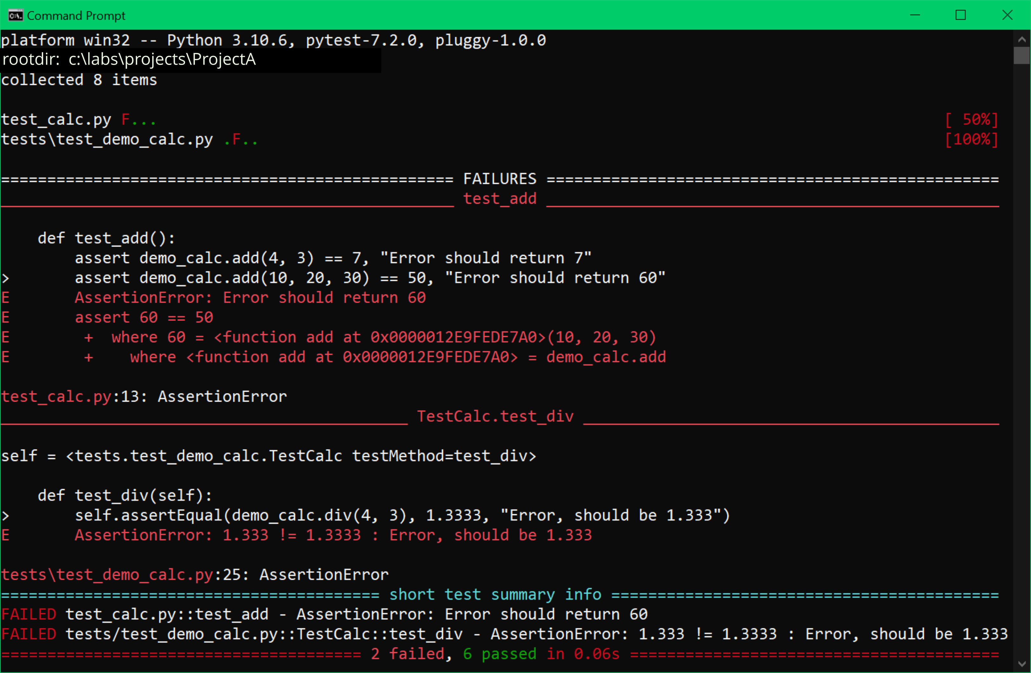
Pytest Output
Reporting failures:
First Failure
Second Failure
Notes:
Edit your test scripts and add an error and rerun the pytest command. In this instance it displays that there were two failures and gives detailed breakdown of the failure, followed by an overall status report.

Slide 29
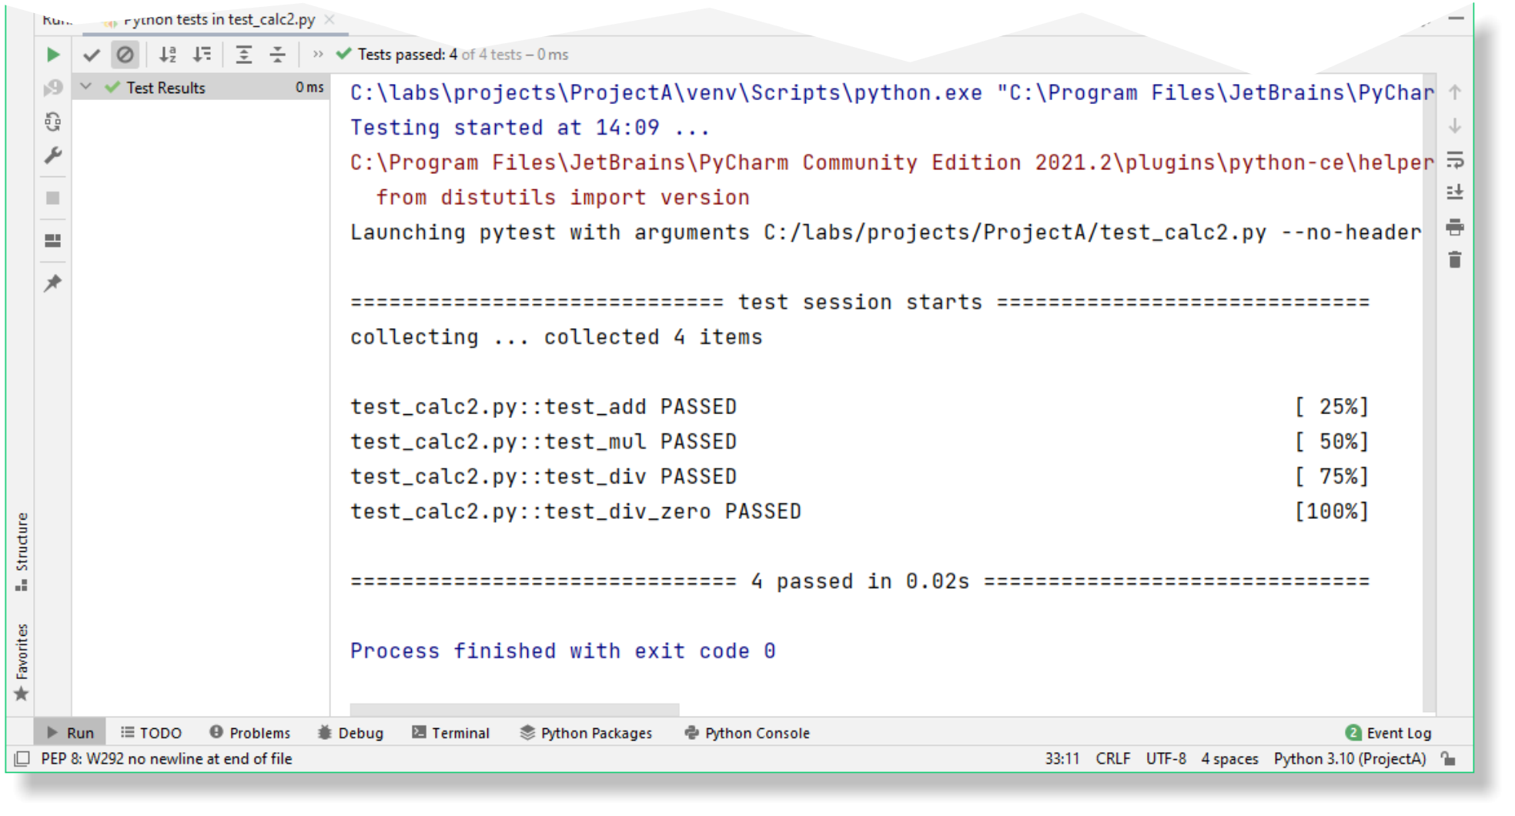
Pytest – Reporting Success in Pycharm
Pycharm – reporting SUCCESS
Right-click > Run Python Tests > script
Or Menu > Run > Run Python Tests> script
Pytest executes your test code
All Passed
Notes:
Fix your test scripts and rerun the tests in Pycharm. In this all tests passed.

Slide 30
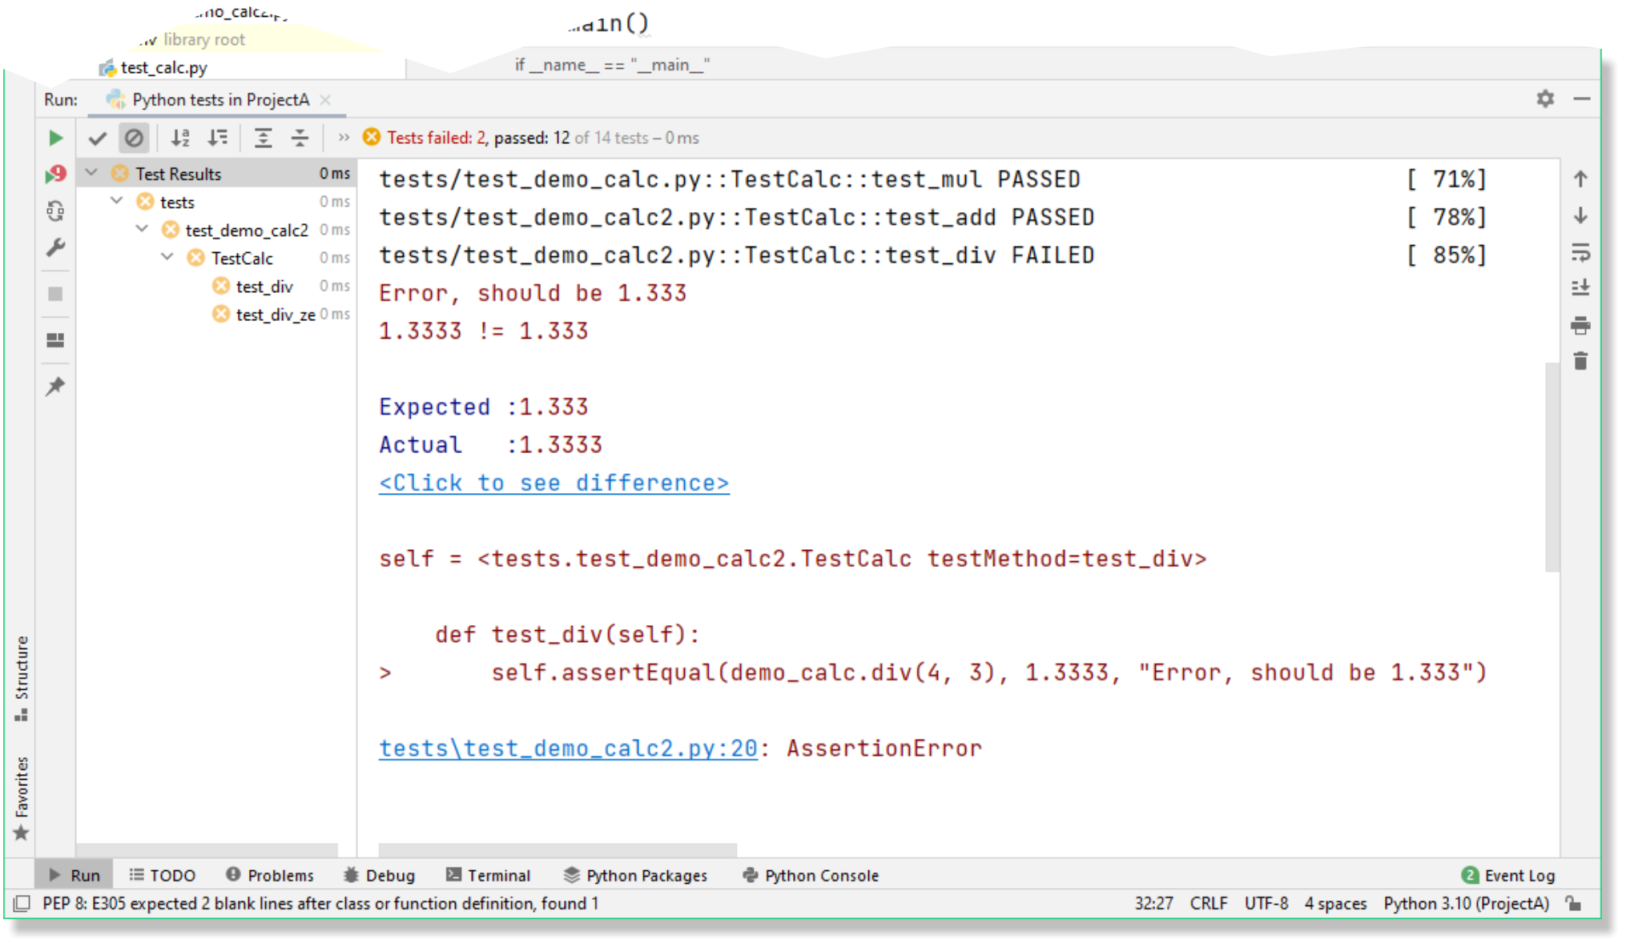
Pytest – Reporting Failure in Pycharm
Pycharm – reporting FAILURE
Edit and add an error to your tests
Right-click > Run Python Tests > script
Or Menu > Run > Run Python Tests > script
Pytest executes your test code
Detailed test report in console
Test Failed
Notes:
Edit your test scripts and add an error and rerun the tests in Pycharm. In this instance it displays that there were two failures and gives detailed breakdown of the failure, followed by an overall status report.

Slide 31
Review & Lab
Answer review questions
Your instructor will guide you which lab exercises to complete

Slide 32
Review Questions
Which of the following statements about software testing is true?
Testing is only needed before deployment
Automated testing removes the need for human testers
Testing helps find and fix problems early in development
Testing guarantees code will never fail
Which built-in Python module provides a framework for writing and running structured test cases?
pytest
doctest
unittest
testcase
Notes:
Answers on next page..

Slide 33
Review Questions
What is the main advantage of automated testing over manual testing?
It requires no setup or maintenance
It runs tests consistently and quickly
It eliminates all bugs
It only works for GUIs
In Python, which statement is used for simple in-code checks or conditions?
verify()
check()
confirm()
assert()
Notes:
Correct answers:
Which of the following statements about software testing is true?
Testing helps find and fix problems early in development
Which built-in Python module provides a framework for writing and running structured test cases?
unittest
What is the main advantage of automated testing over manual testing?
It runs tests consistently and quickly
4. In Python, which statement is used for simple in-code checks or conditions?
assert()

Slide 34
Summary
Why Software Testing Matters
Bugs are costly to fix in production
Good testing protects reputation, performance, and security - and can even save lives
Manual or Automated
Tests can be manual or automated
Automation is faster, consistent, and more reliable
Document Your Code
Use docstrings and the Doctest module to verify examples.
Testing Frameworks
Write test cases and run them with tools like unittest or pytest.
Software testing isn’t optional - it’s essential for:
Quality, trust and maintainability

Slide 35
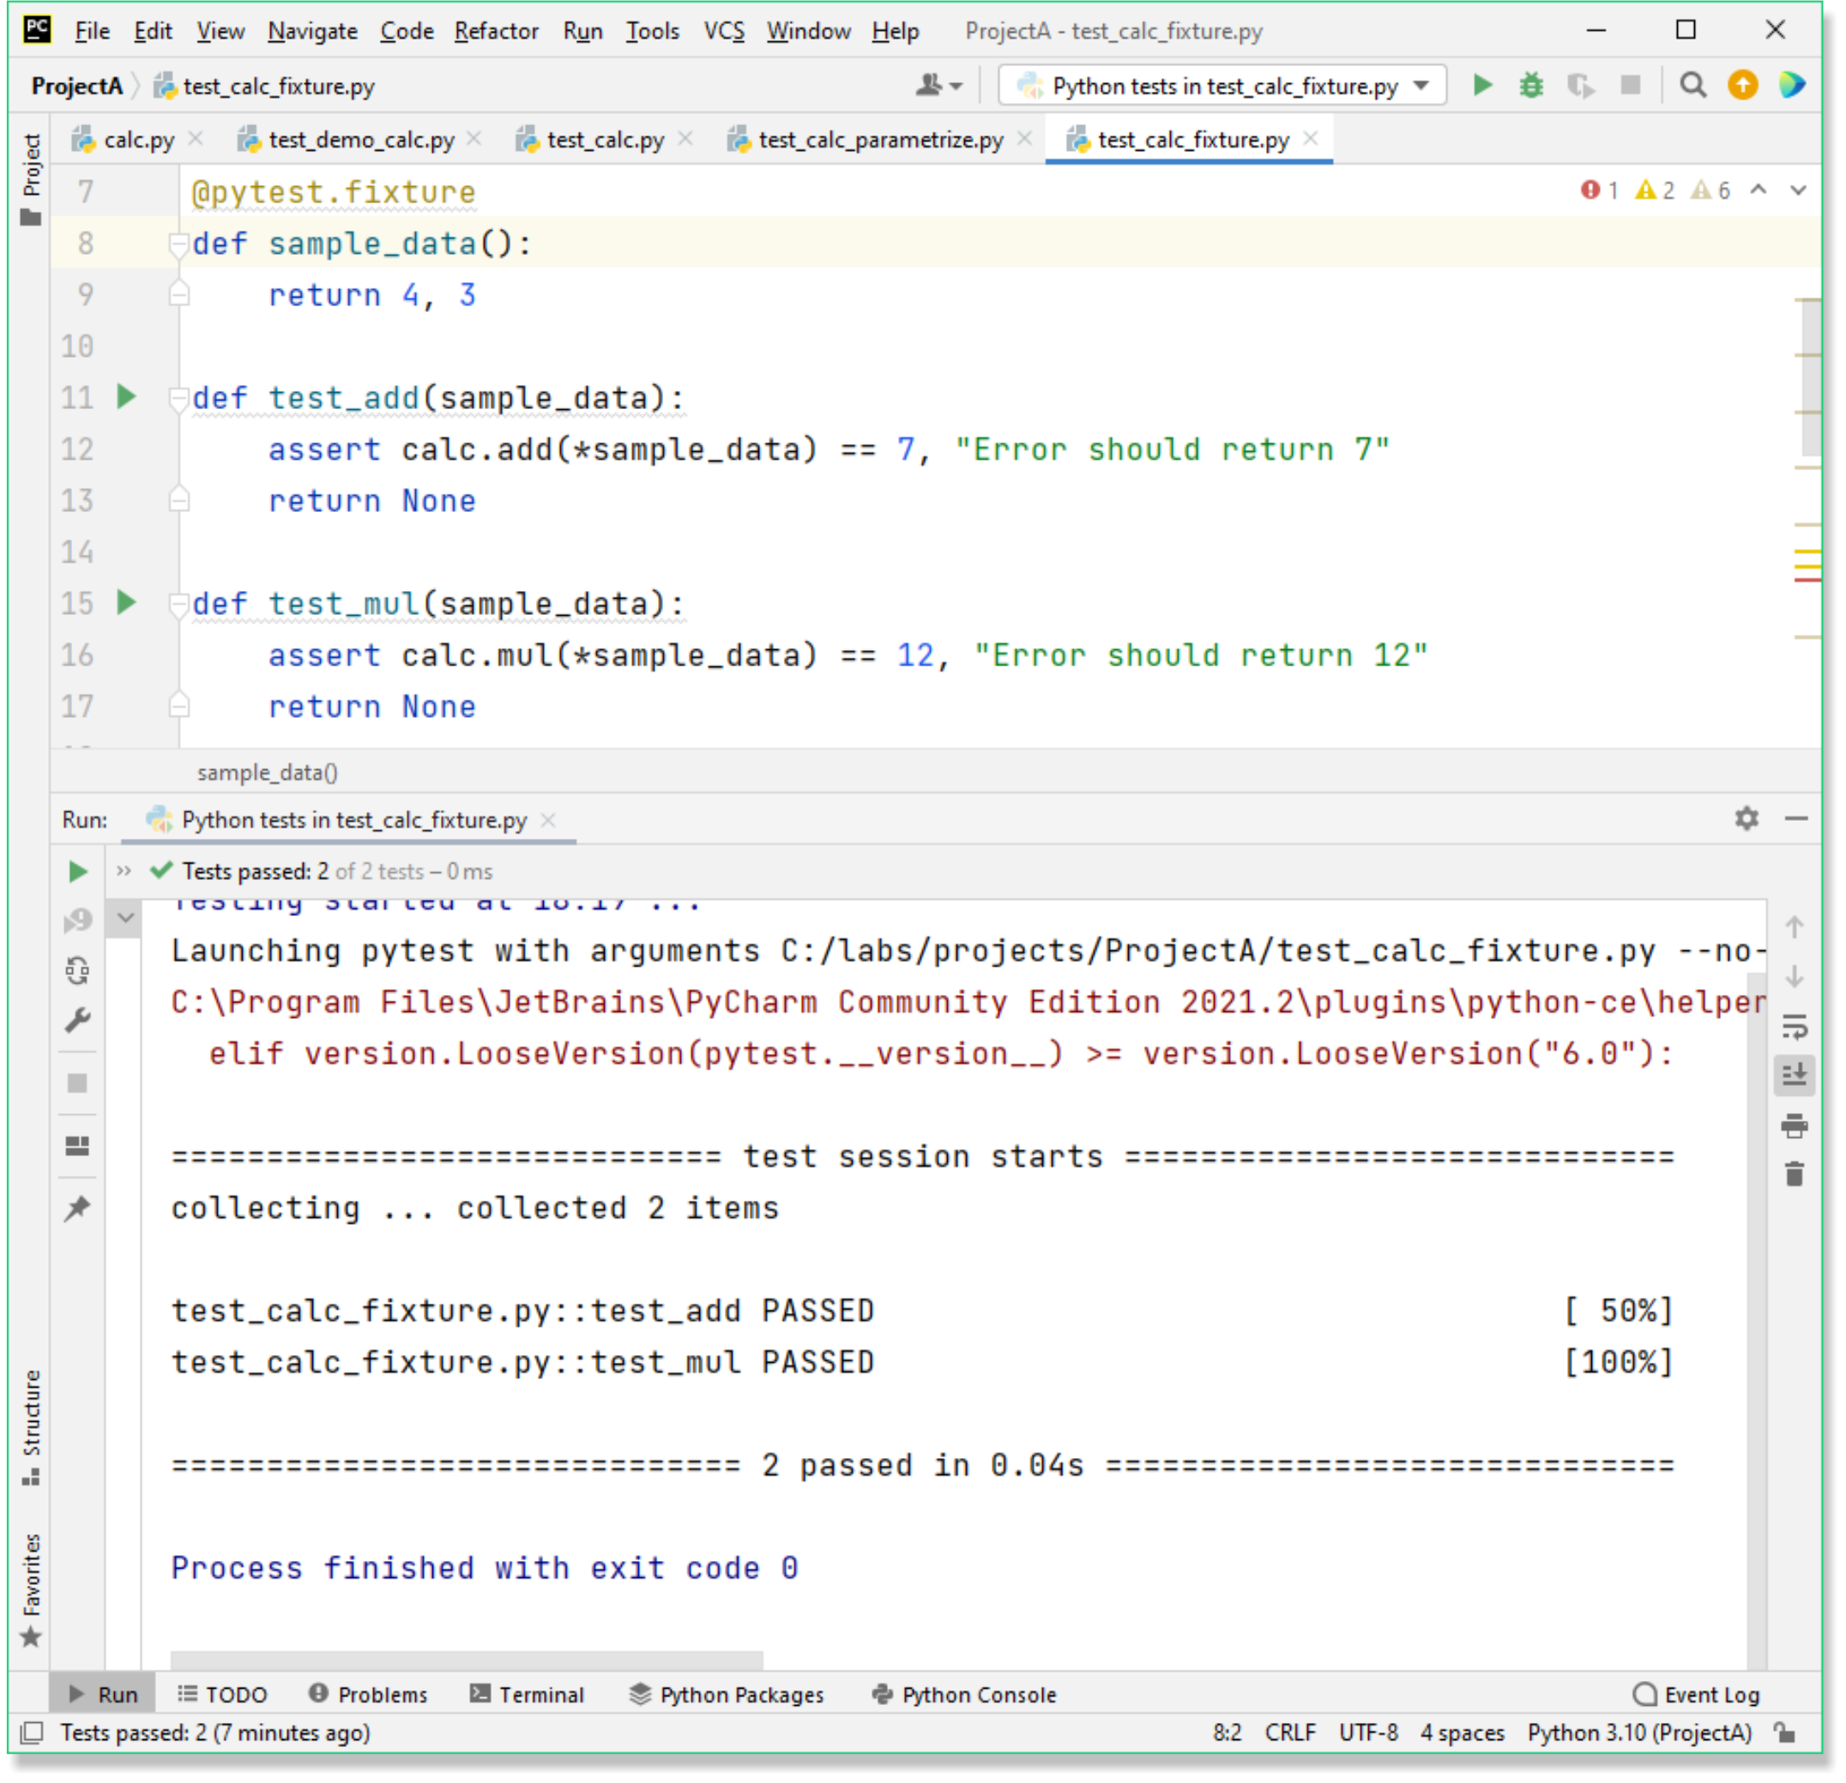
Managing test data - fixtures
Pytest fixture
Special function decorated with @pytest.fixture.
Provides data or test double to the test function.
Test function accepts fixture as a parameter.
Can simplify multiple tests that use same data.
Can be centralised in a module called conftest.py
@pytest.fixture def sample_data(): return 4, 3 def test_add(sample_data): assert calc.add(*sample_data) == 7, "Error should return 7" return None def test_mul(sample_data): assert calc.mul(*sample_data) == 12, "Error should return 12" return None
Notes:
If you have many tests that share the same test data, then you can create a special function in pytest called a fixture. Fixtures are functions that can return a large range of values for your test functions. Like a stunt double, they provide test doubles to your test function, and the test function accepts them explicitly as parameters. In some cases, they can simplify multiple test functions and reduce the amount of boilerplate code.
If you want to make a fixture available to your entire project, then you can place them in a special module called conftest.py. Pytest looks for this module in each directory, but if placed in the project parent directory then it will be available to the parent and all sub directories without importing it.

Slide 36
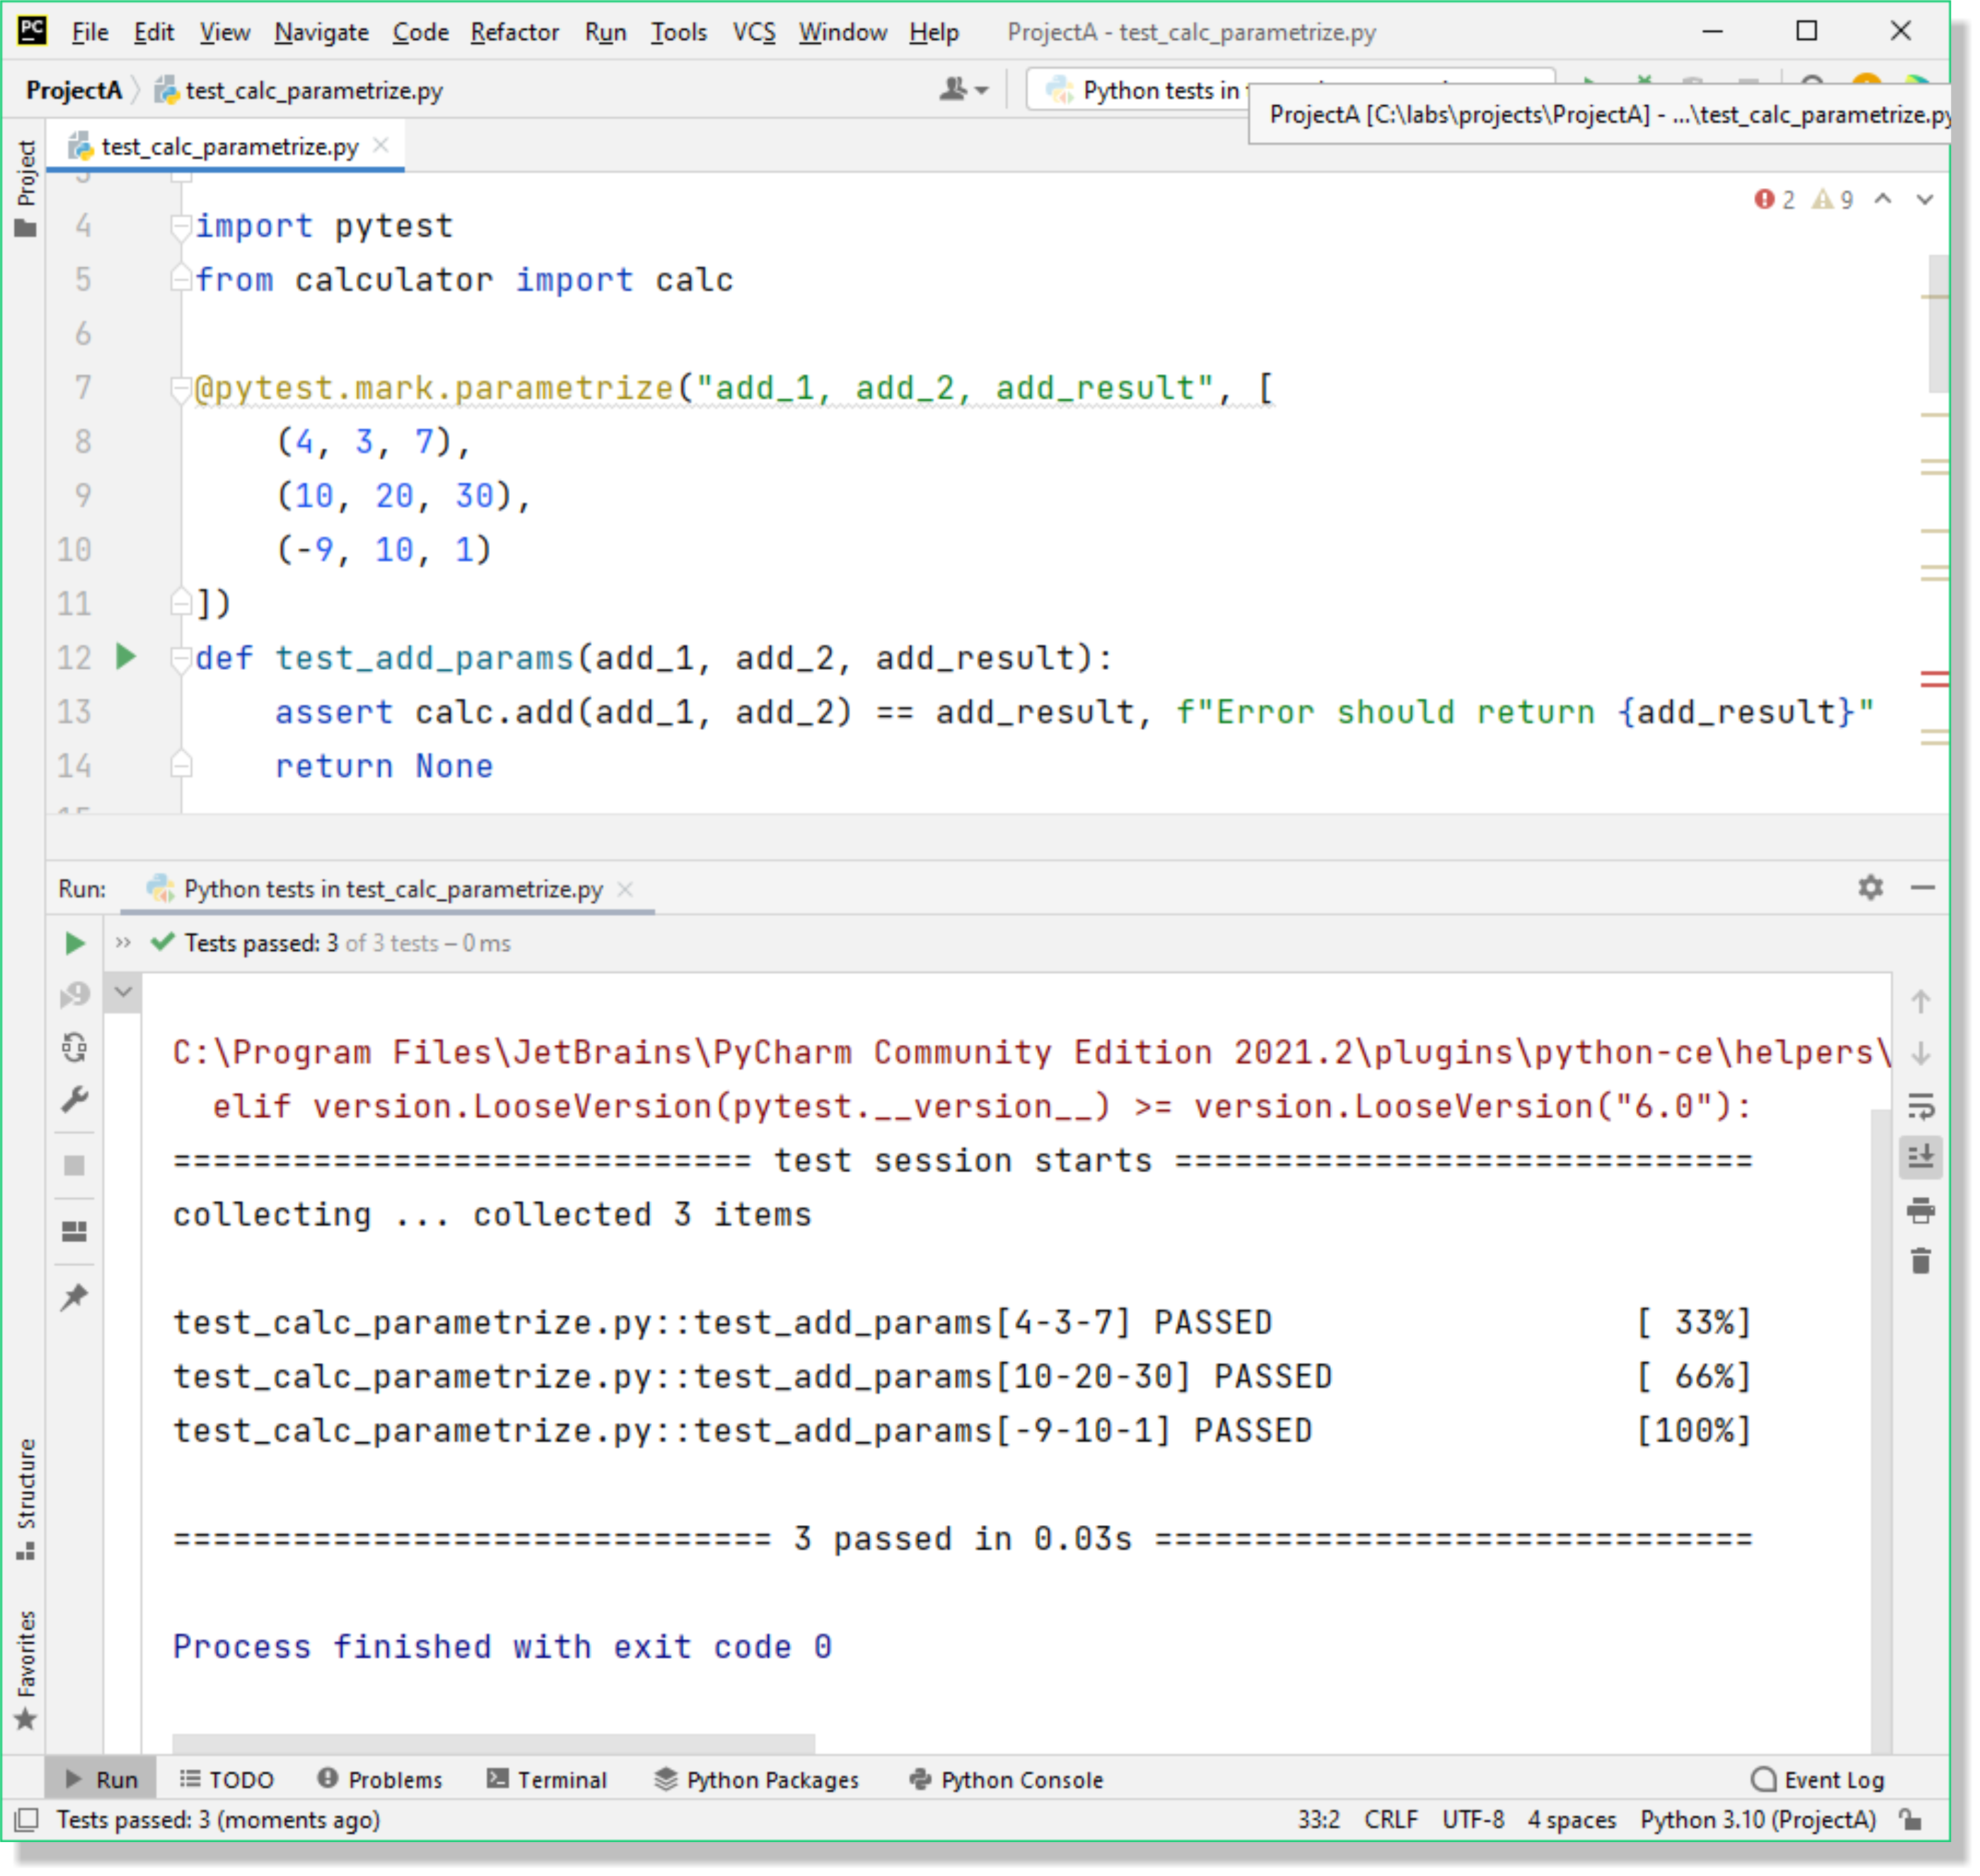
Managing multiple test data - parametrized
Pytest – combining tests
Solution to different inputs and outputs.
Generalises the code.
Scales better.
Uses @pytest.mark.parametrize()
import pytest from calculator import calc @pytest.mark.parametrize("add_1, add_2, add_result", [ (4, 3, 7), (10, 20, 30), (-9, 10, 1) ]) def test_add_params(add_1, add_2, add_result): assert calc.add(add_1, add_2) == add_result,
f"Error should return {add_result}“
return None
Notes:
Fixtures help reduce code duplication by providing reusable setup or common parameters for multiple tests.
However, fixtures are best suited to shared inputs or outputs, not when your test data varies slightly between cases.
For tests with different input–output combinations, pytest allows you to combine and generalise test data using the @pytest.mark.parametrize() decorator.
The first argument is a comma-separated string of parameter names representing the inputs and expected results.
The second argument is a list or tuple containing the specific data sets to be tested.
Note: Avoid over-complicating your parameterization - tests should remain clear, simple, and easy to read.

